Slide 1




VGI road network evolution from a user’s point of view
Raphaël Bres Verónika Peralta Arnaud Le-Guilcher Thomas Devogele Ana-Maria Olteanu Raimond
Cyril de Runz
Séminaire BDTLN

Slide 2
Context
Volunteered Geographical Information (VGI)
Helpful for citizens
Behind many applications in routing
Data quality is uncertain
Road network
Many users with different needs
Quickest route
Safest route
Most beautiful route
Different information needed

Slide 3
Context
Cycling network
Set of every road and track where cyclists are allowed on their bike or pushing their bike
Difficult object to define
Intersection of different networks
Cycling infrastructures (cycle tracks, cycle lanes, shared ways)
Motor vehicle infrastructures (road without cycling infrastructures)
Pedestrian infrastructures (pedestrian ways, steps)

Slide 4
Objectives and constraints
Propose a VGI evolution analysis dedicated to the cycling usage
Firstly, with an exhaustive road section data evolution analysis
Secondly with a non exhaustive route data evolution
Propose a graph-based model for VGI evolution analysis
Model for road sections (edges) and intersections (vertices)
Constraint:
Adapt the graph model to my ideal cycling model (not today’s subject)
Contributions:
Method to analyze VGI evolution with the perspective of a specific user
A graph to analyze VGI evolution
A state of the cycling network in Centre Val de Loire between 2014 and 2022 accordingly to our proposed method

Slide 5
Overview
Related work on OSM data evolution
Cycling network definition
Graph model for VGI evolution
VGI evolution analysis method
Results
Conclusion & future work

Slide 6
Related work on OSM data evolution
VGI term created by Goodchild
First OSM data evolution studies
Neis et al
Cycling network data analysis
Bres et al
2007
2011
2023
2004
2010
2019
OSM creation
First data quality studies
Girres and Touya
OSHDB format to analyze data
Evolution
Raiffer et al

Slide 7
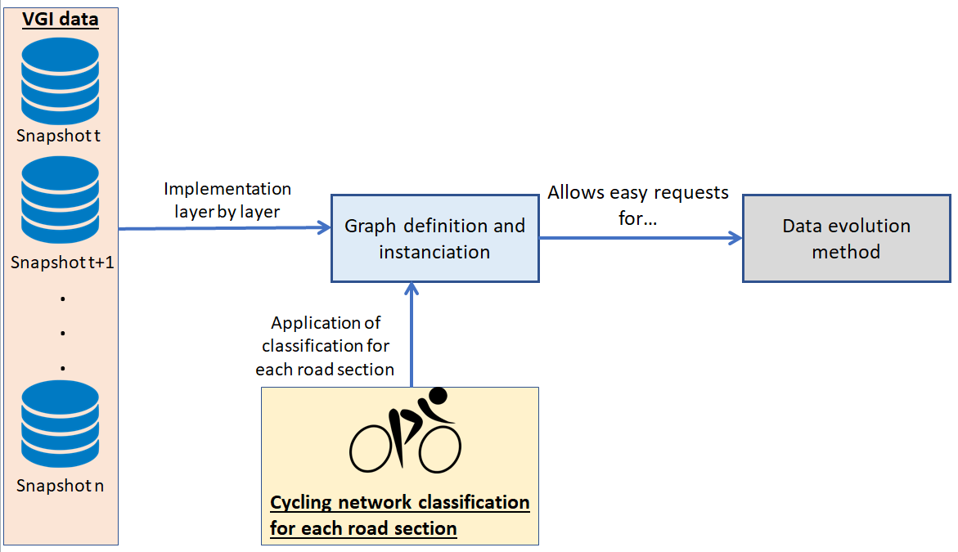
Pipeline

Slide 8
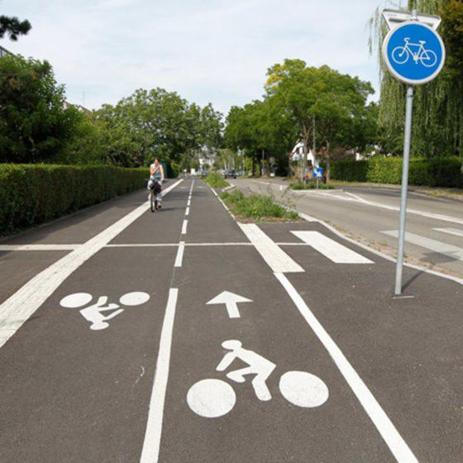
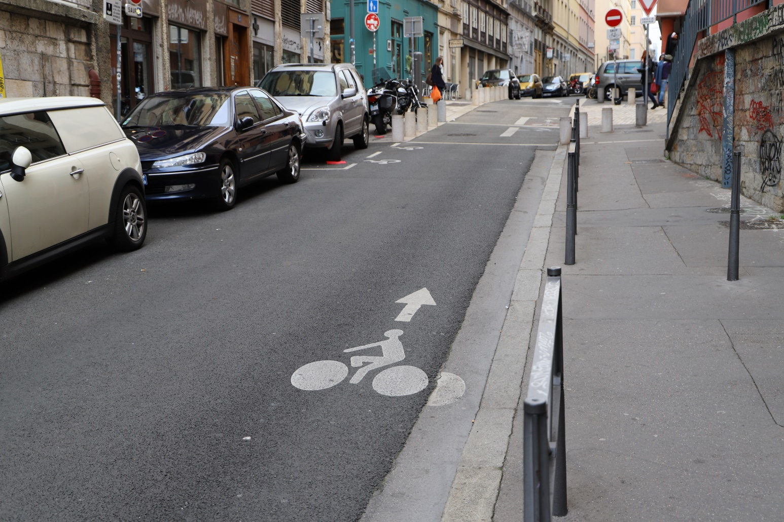
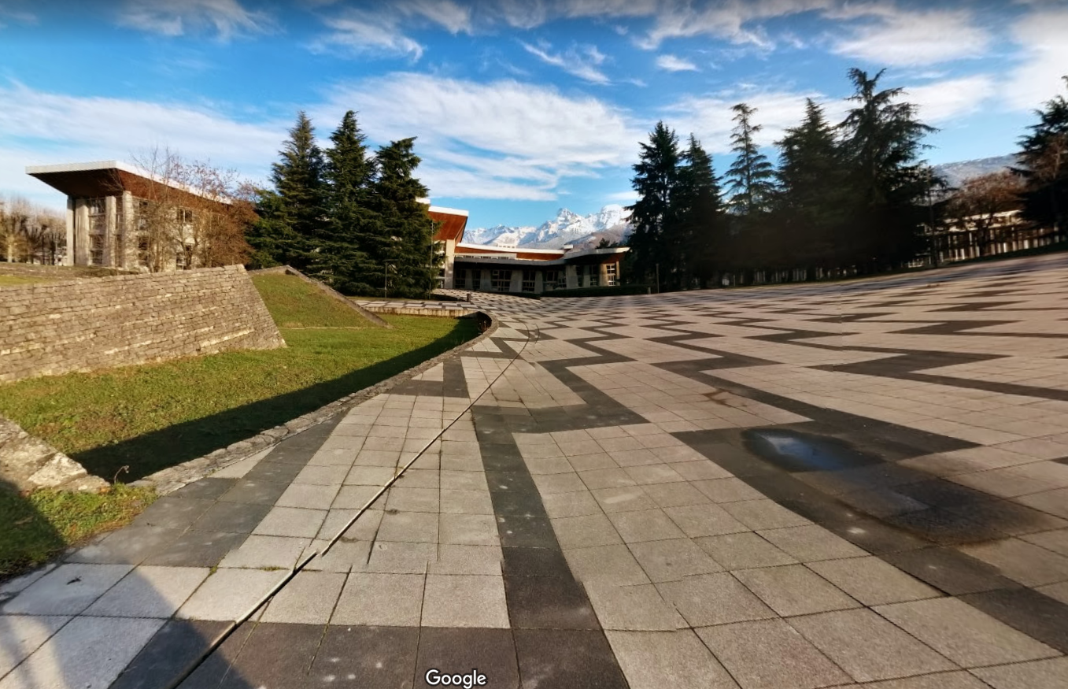
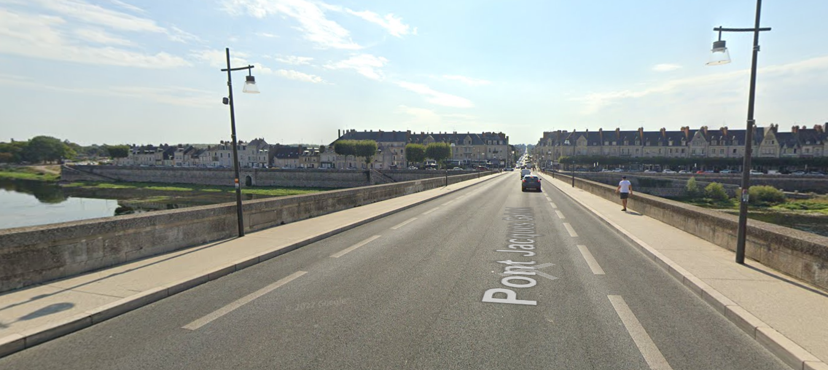
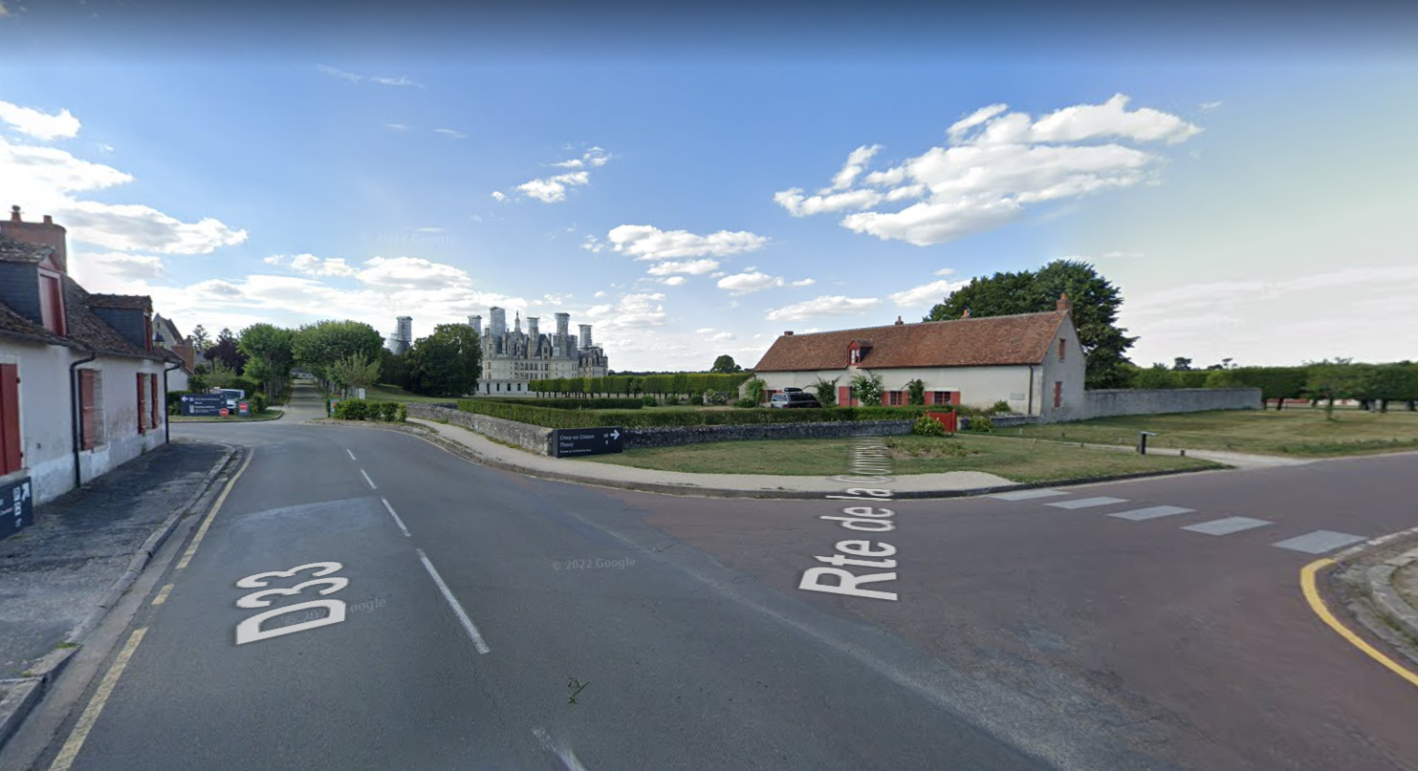
Cycling network : definition (reminder)
$$N_{C}= N_{IC}∪N_{P} ∪(N_{M} \backslash \left(N_{MW}∪N_{HW}\right))$$
Notes:
Reprendre animation de l’équation en fonction de l’avancement

Slide 9
Pipeline

Slide 10
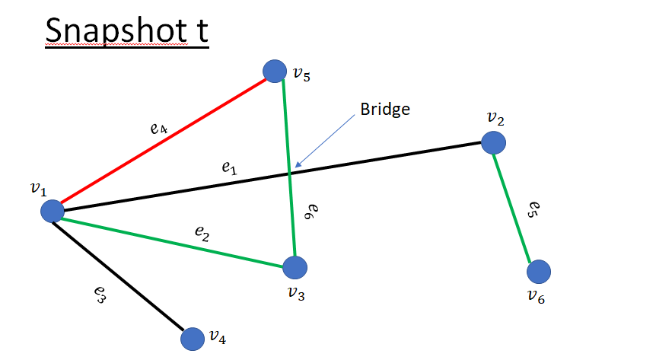
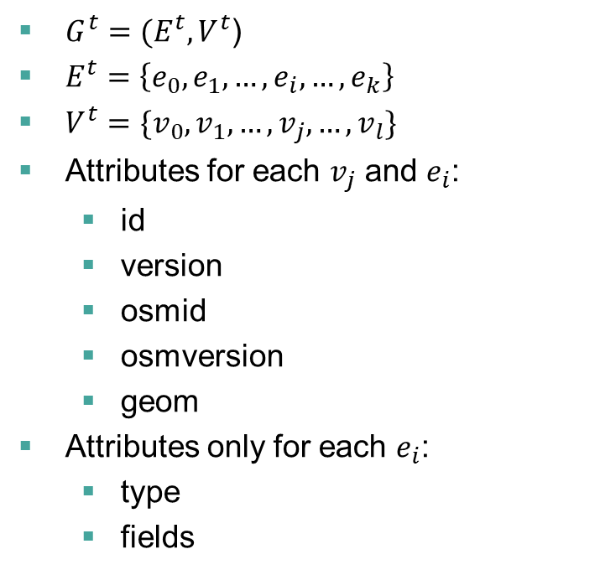
Multiplex graph to analyze VGI evolution
$G^{t}=(E^{t}, V^{t}$)
$E^{t}=\left\{e_{0},e_{1}, …, e_{i}, …, e_{k}\right\}$
$V^{t}=\{v_{0}, v_{1}, …, v_{j}, …, v_{l}\}$
Attributes for each $v_{j}$ and $e_{i}$:
id
version
osmid
osmversion
geom
Attributes only for each $e_{i}$:
type
fields

Slide 11
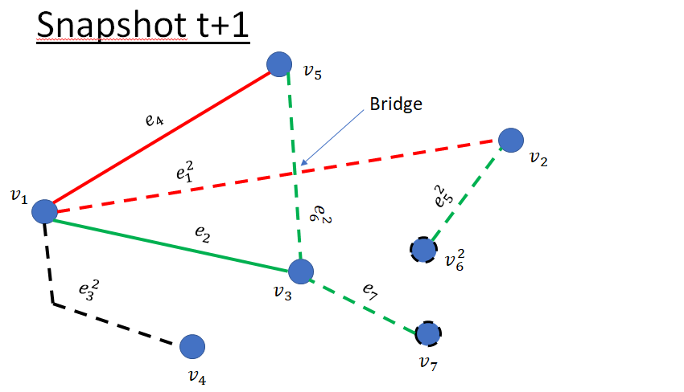
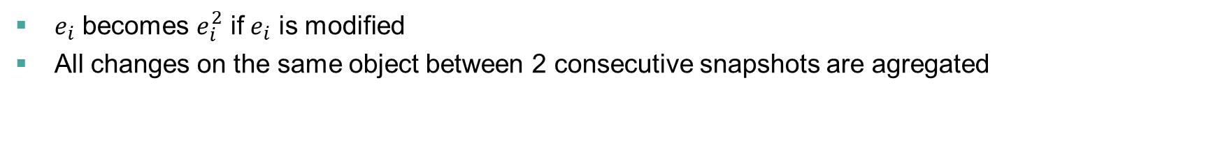
Evolution of the multiplex graph
$e_{i}$ becomes $e_{i}^{2}$ if $e_{i}$ is modified
All changes on the same object between 2 consecutive snapshots are agregated
Notes:
légende

Slide 12
Pipeline

Slide 13
Road section approach
Exhaustive data evolution analysis on all the area of study centered on each road section (named way) individually
2 types of indicators:
Indicators based on a given snapshot
Length of road sections for each semantic class
Indicators based on the evolution between 2 consecutive snapshots
Length of road sections added to the network
Evolution matrix between the semantic classes

Slide 14
Routes approach
Non exhaustive approach (Bres et al 2023)
Way centrality indicator: number of routes using one road section
Goal: find the consequences of a major and/or many minor changes in the cycling network
Percentage of cycling infrastructures used in a given route
Cycle paths, cycle lanes and shared ways
Goal: measure the use and the availability of the cycling network

Slide 15
Results for the road section approach

Slide 16
Evolution of data: road-based approach
Tables unit: km

Slide 17
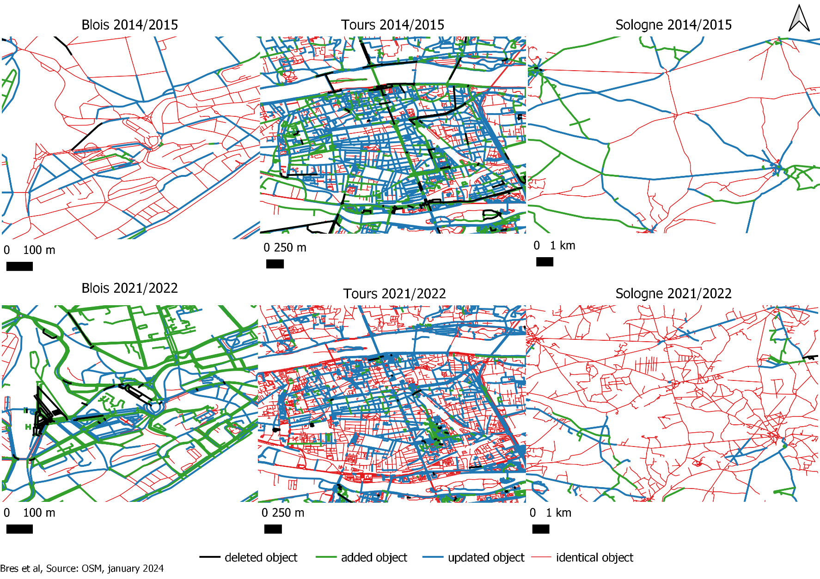
Examples of cycling network evolution

Slide 18
Results for the routes approach

Slide 19
Evolution of data: mean of way centrality indicator
Indicator in [1:1000]

Slide 20
Evolution of data: maximum of way centrality indicator
Indicator in [1:1000] Motor vehicles network Cycle lane

Slide 21
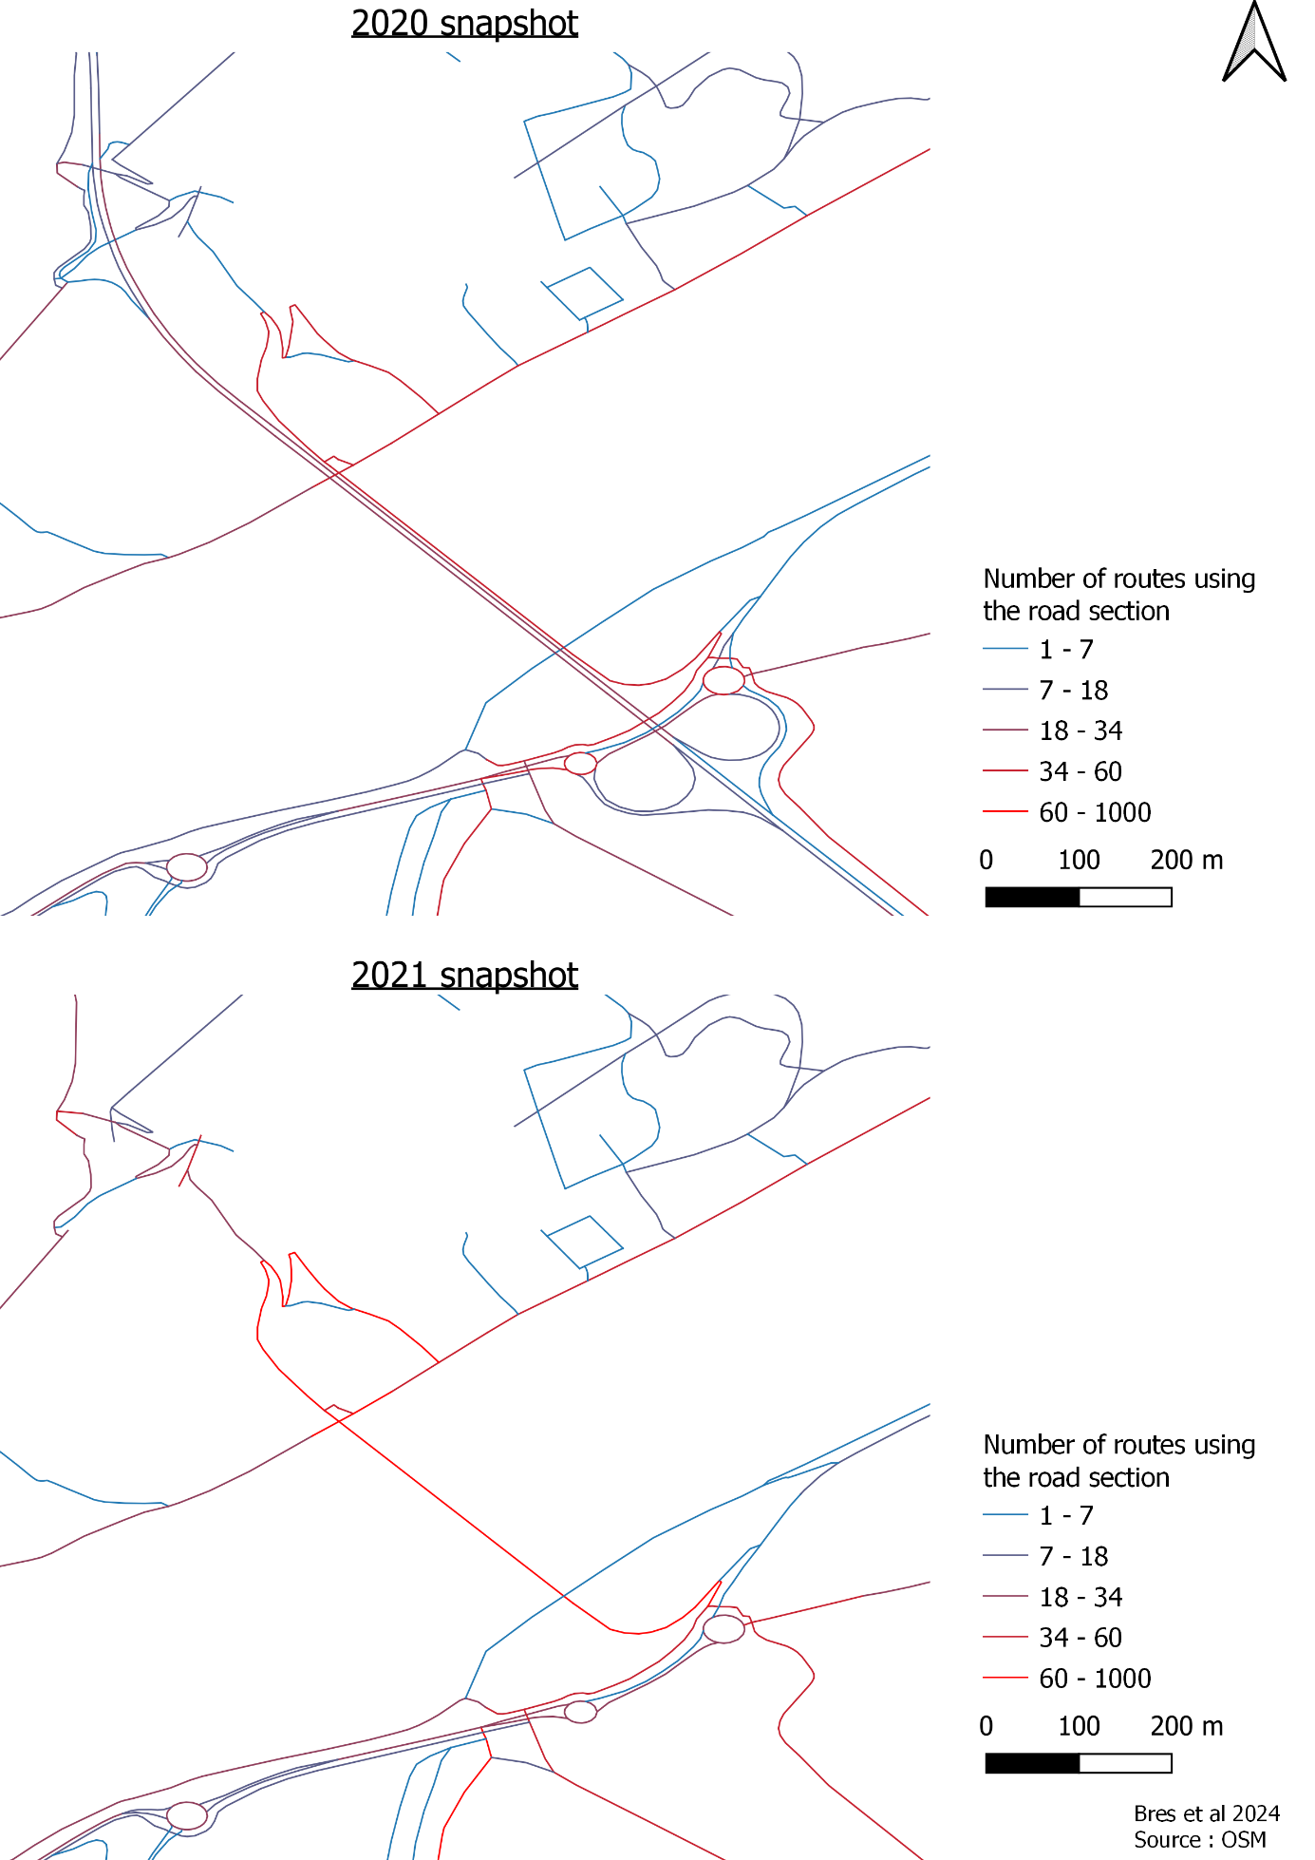
Way centrality indicator around Pont Charles de Gaulle (Blois) in 2020 and 2021

Slide 22
Conclusion and future work
Pipeline to analyze VGI evolution based on 2 complementary methods
Usable for any road user!
A tool to analyze VGI evolution
A state of OSM cycling network in Centre Val-de-Loire between 2014 and 2022
Future work:
Many results possible with the data evolution method
Upgrade the route generator
Detecting automatically if a change in a route occurred thanks to a creation or update of a specific road section

Slide 23
Thank you! Any questions?

